Slide 1
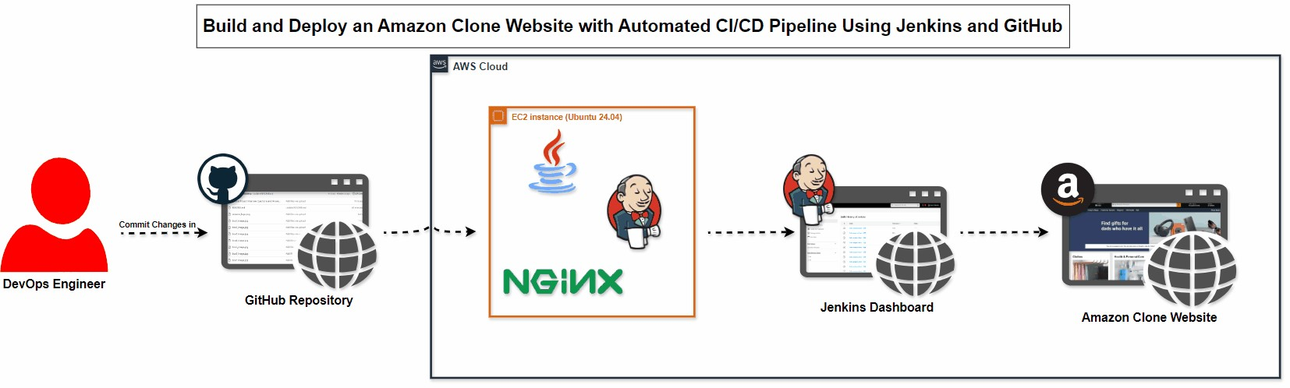
Amazon Clone Website Integrated with CI/CD Pipeline using Jenkins and GitHub
Aim:
The aim of this project is to build an Amazon clone website integrated into a Continuous Integration and Continuous Deployment (CI/CD) pipeline using Jenkins. The pipeline automates code building, testing, and deployment to an NGINX server hosted on an AWS EC2 instance. This project highlights how DevOps practices streamline web development and deployment processes.
Components:
Amazon Clone Website: A fully functional web application mimicking the functionality of Amazon's e-commerce platform.
CI/CD Pipeline:
GitHub: Source code repository and version control system.
Jenkins: Automation server that orchestrates building, testing, and deploying the code.
GitHub Webhook: Triggers Jenkins to initiate the build process when code is pushed or updated.
AWS EC2 Instance: Hosts the NGINX web server and runs the deployed Amazon clone website.
NGINX: Web server responsible for serving the Amazon clone website.
GitHub Token: Credentials used to securely integrate GitHub with Jenkins for automated
builds.
Architecture:

Slide 2
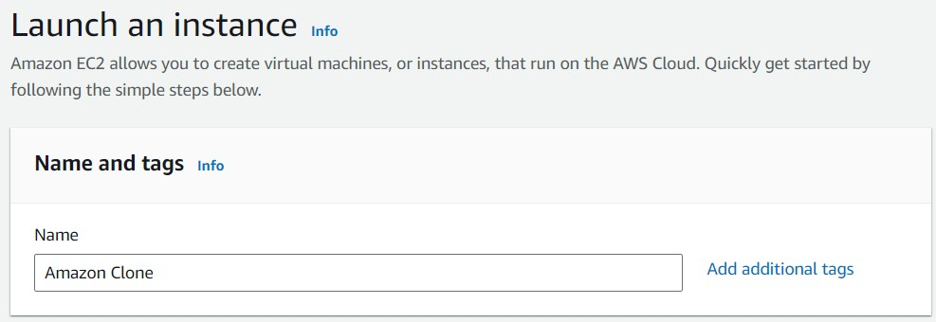
Problem Definiton:
Developing and deploying web applications can be time-consuming and error-prone without automation. Manual deployment processes often lead to inconsistencies, delays, and configuration issues. This project solves these challenges by automating the entire process, from code push to deployment, using Jenkins and a CI/CD pipeline. This ensures faster, more reliable, and repeatable deployments.
Steps:
Create an EC2 Instance
Instance Name: Amazon Clone
AMI: Ubuntu 24.04
Instance Type: t2.micro
Security Group: Enable
HTTP
HTTPS
Custom TCP (8080, Anywhere)
Custom TCP (8000, Anywhere)
Action: Launch the instance.

Slide 3
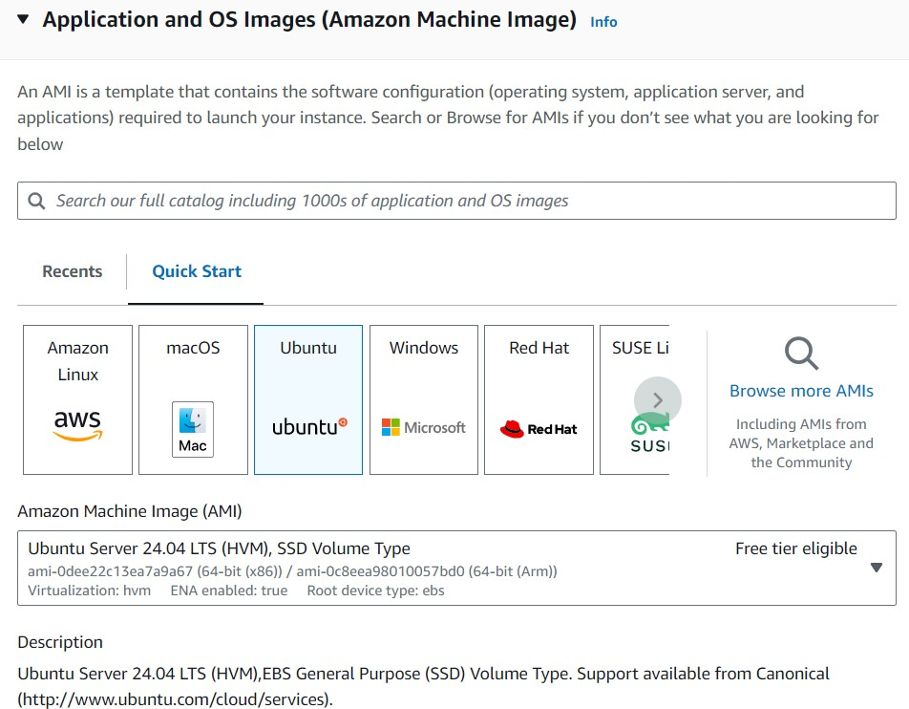
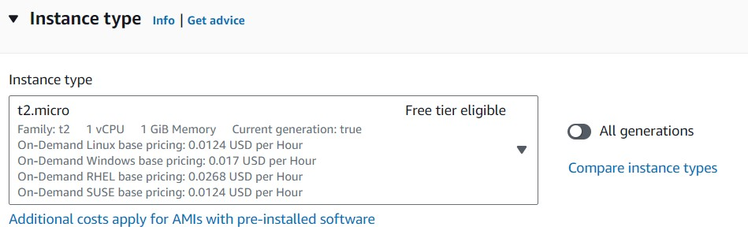

Slide 4
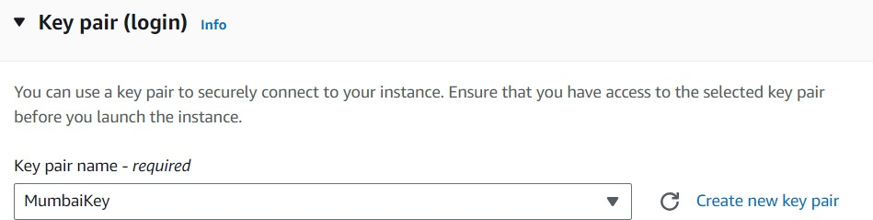
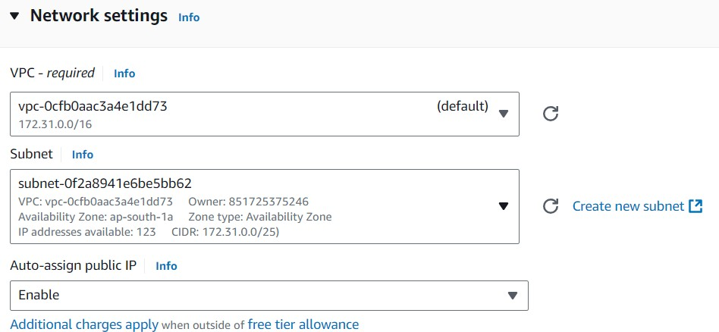

Slide 5
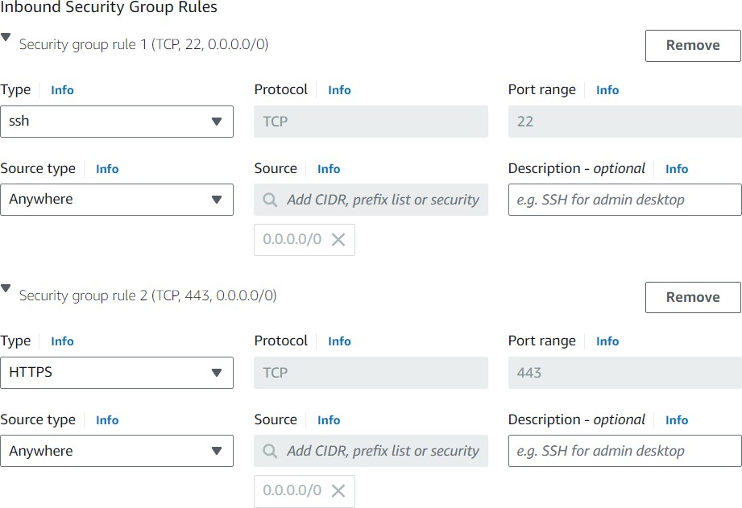
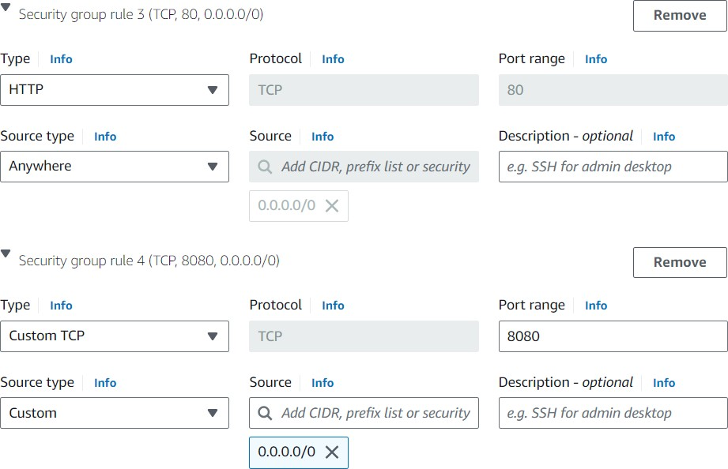

Slide 6
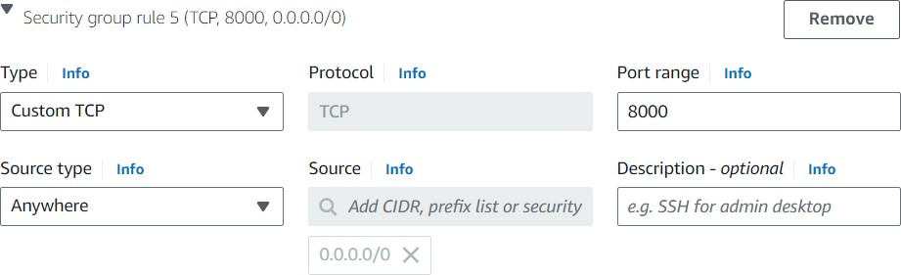
2. Connect to the EC2 Instance and Install Required Packages
Run the following commands in the terminal after connecting via SSH:
# Update the package list
sudo apt update
# Install OpenJDK 17
sudo apt install openjdk-17-jdk
# Verify the Java installation java -version
# Add the Jenkins GPG key
sudo wget -O /usr/share/keyrings/jenkins-keyring.asc https://pkg.jenkins.io/debian- stable/jenkins.io-2023.key
# Add Jenkins repository to the sources list
echo "deb [signed-by=/usr/share/keyrings/jenkins-keyring.asc] https://pkg.jenkins.io/debian-stable binary/" | sudo tee /etc/apt/sources.list.d/jenkins.list
> /dev/null

Slide 7
# Update the package list
sudo apt-get update
# Install Jenkins
sudo apt-get install jenkins
# Enable Jenkins to start on boot and start the service
sudo systemctl start jenkins
sudo systemctl enable jenkins
# Check Jenkins status
sudo systemctl status jenkins
# Install and start Nginx
sudo apt install nginx -y
sudo service nginx start
# Enable Nginx to start on boot
sudo service nginx enable
# Check Nginx status
sudo service nginx status
#To install the required packages for using Docker
sudo apt install apt-transport-https ca-certificates curl software properties-common -y

Slide 8
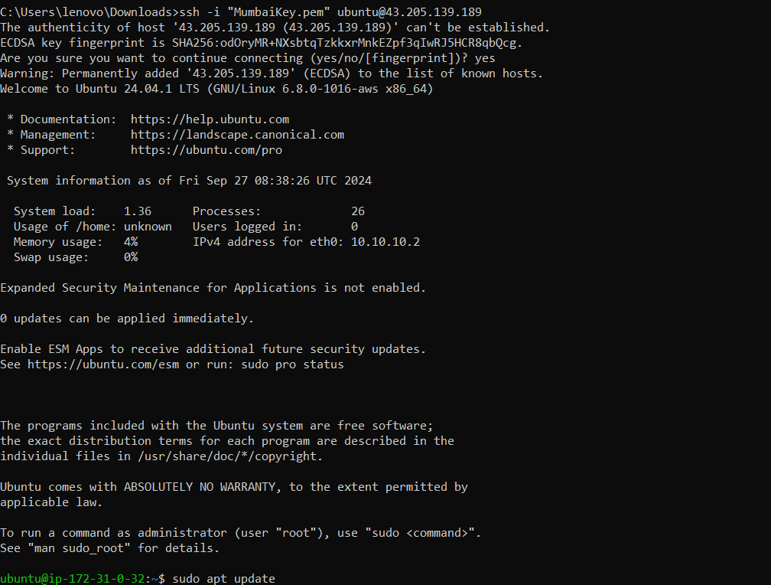

#you provided is intended to download Docker's GPG key and save it to your system's keyring.
sudo curl -fsSL https://download.docker.com/linux/ubuntu/gpg -o /etc/apt/keyrings/docker.asc
#you provided adds the Docker repository to your system's package sources.
echo "deb [arch=$(dpkg --print-architecture) signed-by=/etc/apt/keyrings/docker.asc] https://download.docker.com/linux/ubuntu $(lsb_release -cs) stable" | sudo tee /etc/apt/sources.list.d/docker.list > /dev/null
#refresh the package index on your Ubuntu system
sudo apt update –y
#To install Docker and its related components on your Ubuntu system
sudo apt-get install docker-ce docker-ce-cli containerd.io docker-buildx-plugin docker-compose-plugin -y

Slide 9
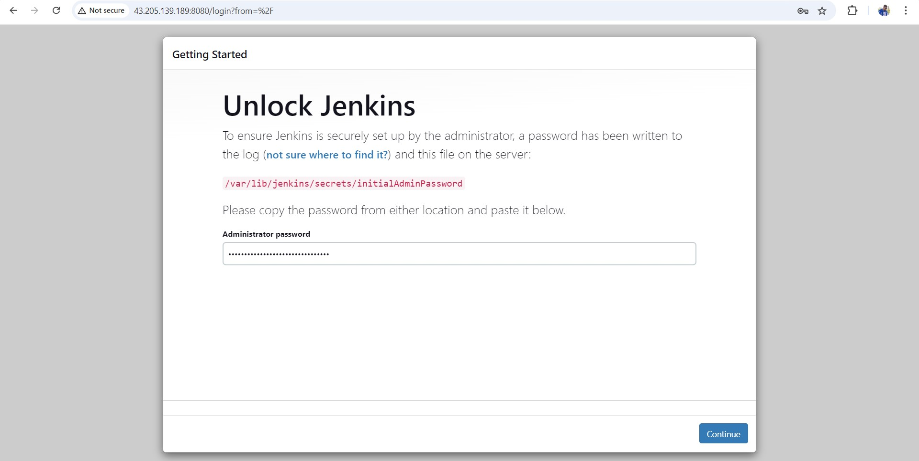
Access Jenkins
Copy the Public IP Address of the EC2 instance and paste it into a browser followed by :8080.
o Example: http://43.205.241.55:8080
Use the initialAdminPassword located in
Cat /var/lib/jenkins/secrets/initialAdminPassword.
Follow the Jenkins setup steps:
Click Install Suggested Plugins.
Create a username, password, and provide email details.
Click Save & Continue and Start Using Jenkins

Slide 10
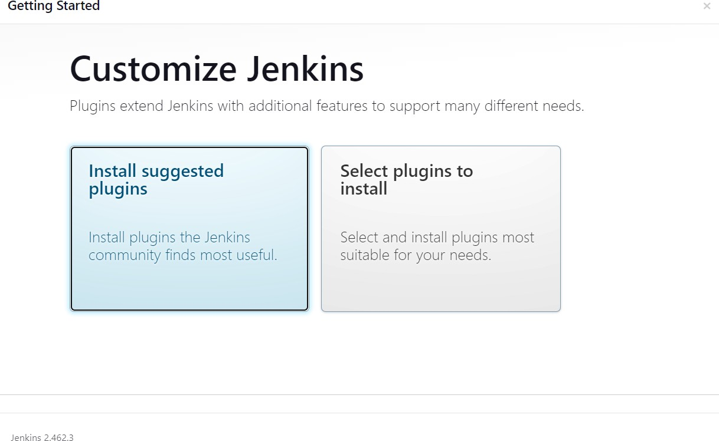
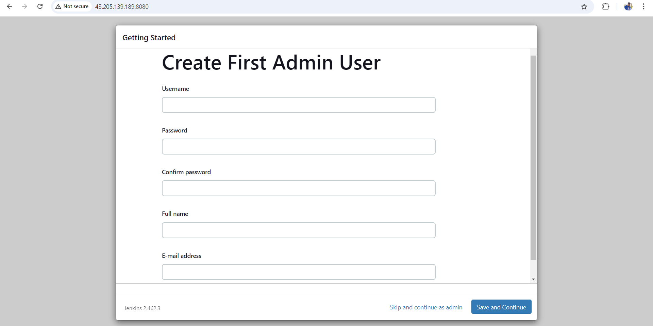
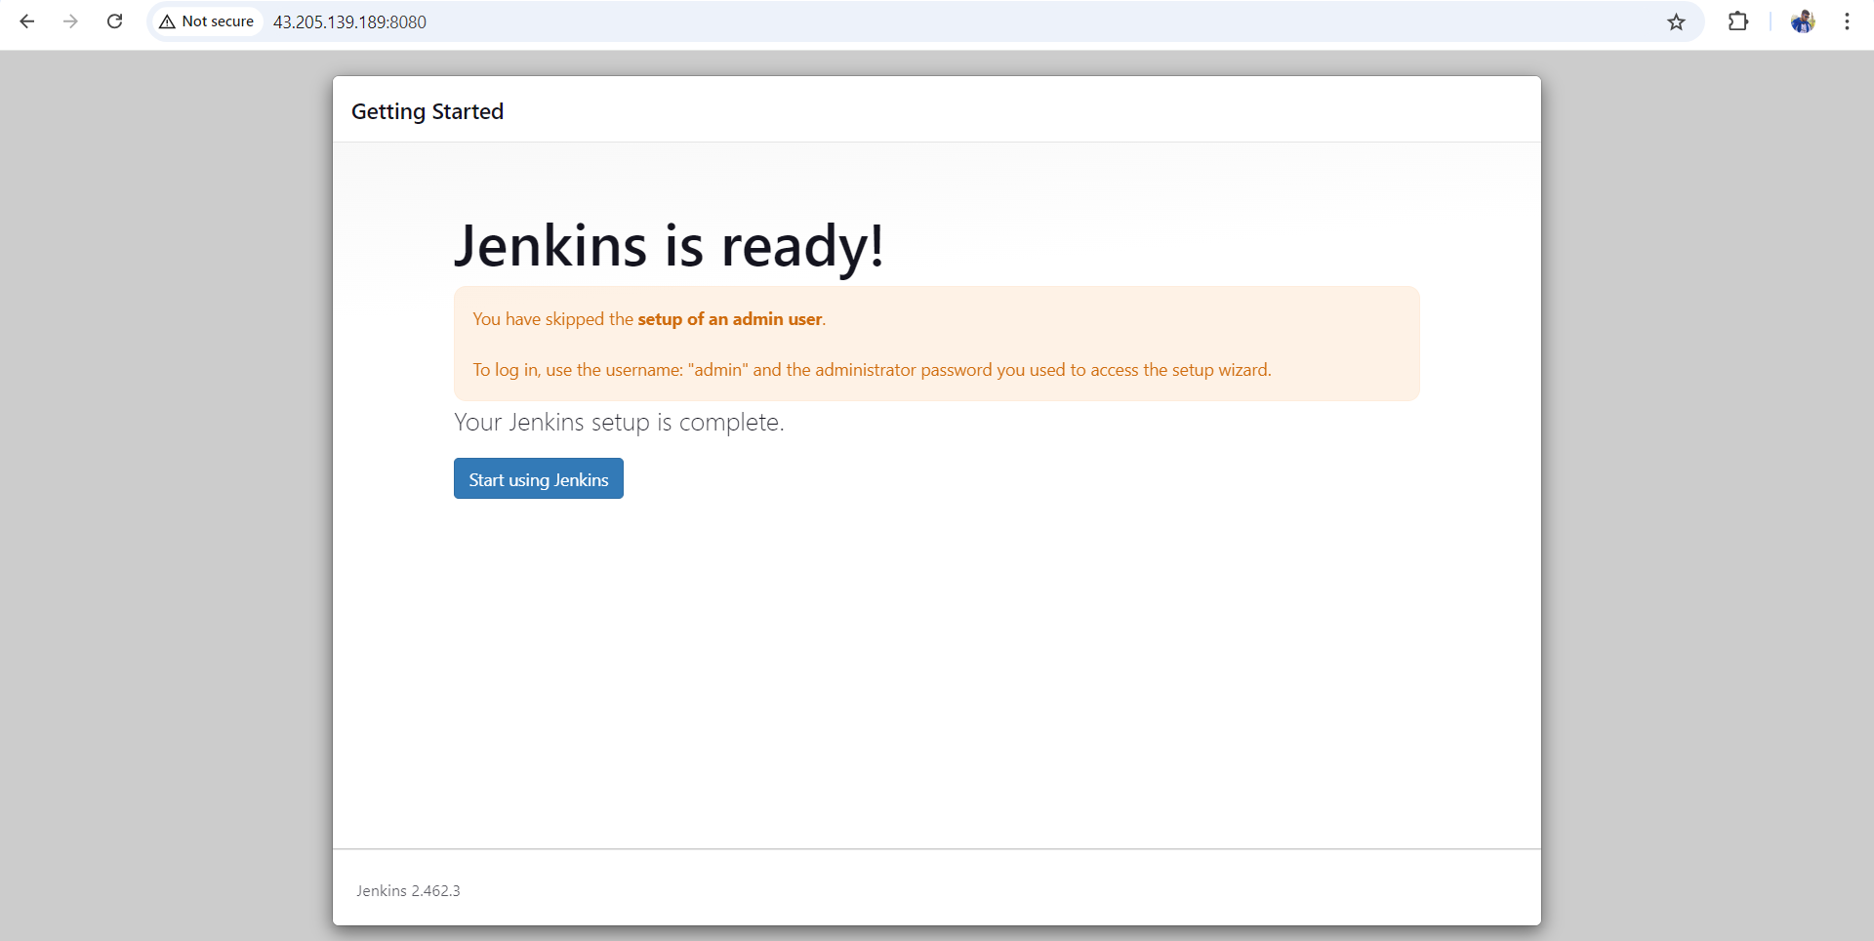

Slide 11
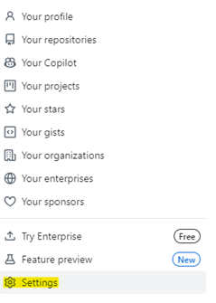

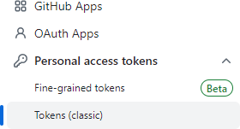
Create GitHub Personal Access Token
Go to GitHub Profile → Settings → Developer Settings → Personal Access Tokens (classic).
Generate a new token:
Note: Jenkins-CICD
Expiration: 30 days
Scopes: Enable repo and workflow.
Copy the Personal Access Token.

Slide 12
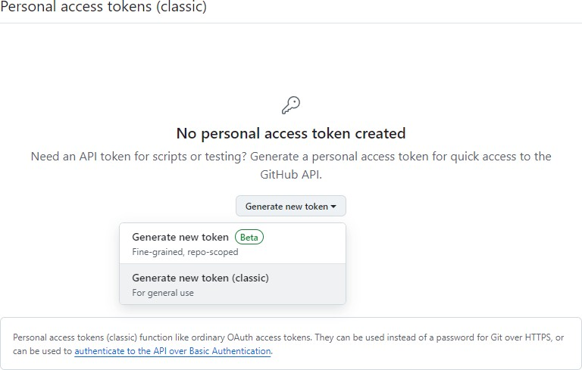
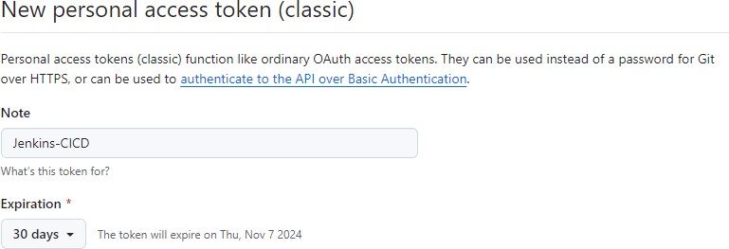
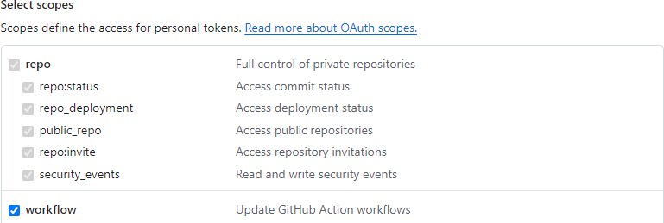

Slide 13
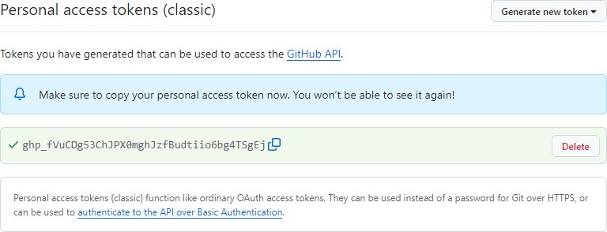
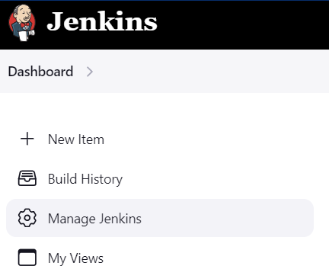
Connect Jenkins to GitHub
In Jenkins:
Navigate to Manage Jenkins → Configure System.
Scroll down to GitHub Server:
Name: GitHub
API URL: https://api.github.com
Credentials: Add the Personal Access Token.
Kind: Secret Text
Secret: (Paste the personal access token).
ID: Jenkins-For-CICD.
Test the connection to see your GitHub username and Save.

Slide 14
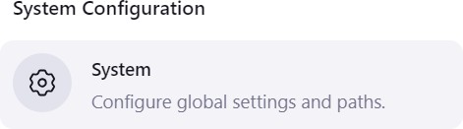
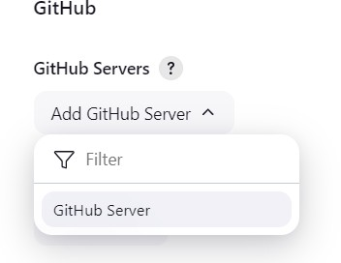
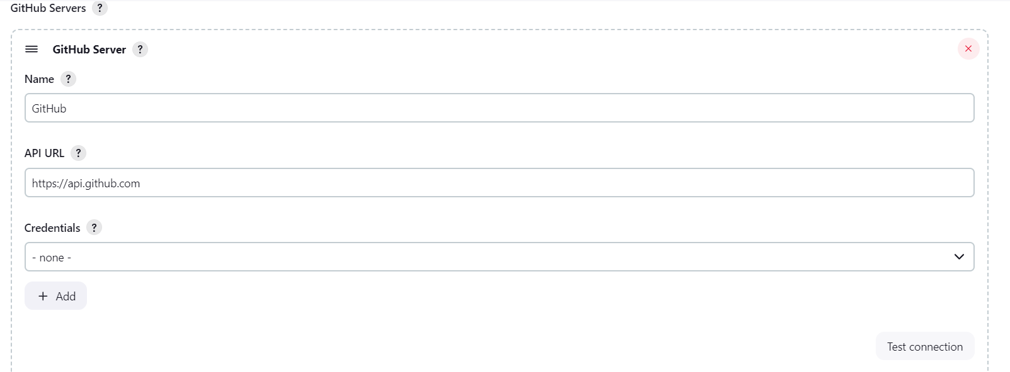
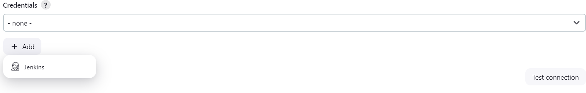

Slide 15
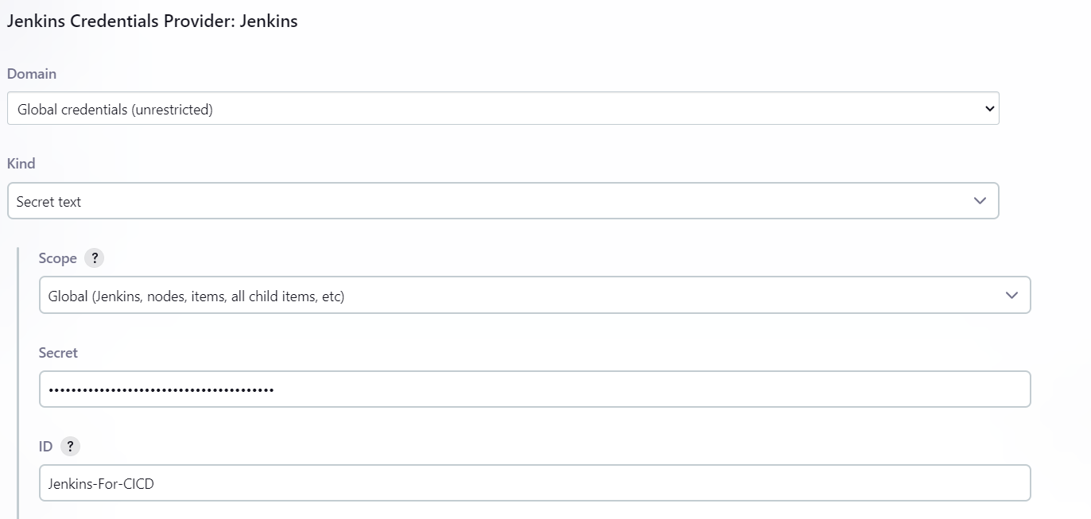

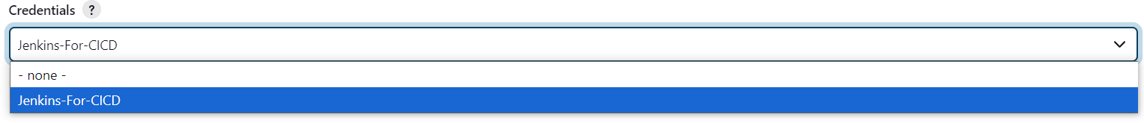

Credentials verified for user Rekhach9618, rate limit: 4999
Create a Jenkins Job
In Jenkins, create a new item:
Item Name: kdm-amazon-clone
Type: Freestyle Project
General: Enable GitHub Project and provide the repository URL.
Source Code Management:
Repository URL: https://github.com/Rekhach9618/AMAZON-CLONE.git
Branch Specifier: */main

Slide 16
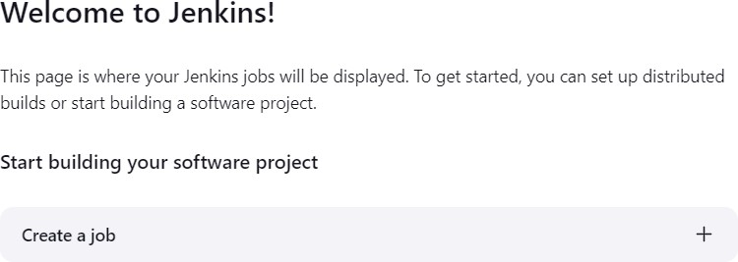
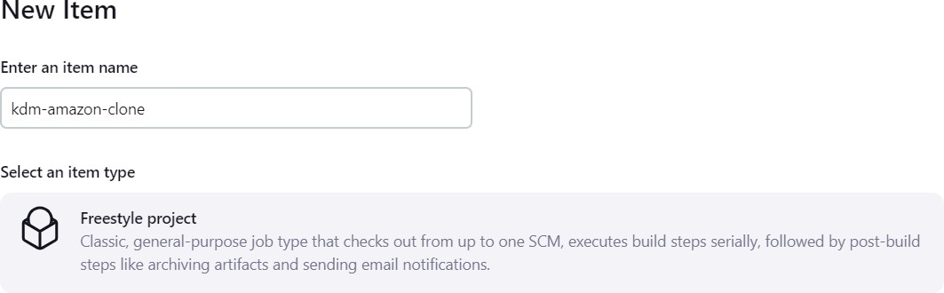

Build Steps:
Add build step: Execute Shell and enter the following commands:
sudo docker ps --filter "publish=8000" -q | xargs -r docker rm -f
sudo docker build . -t kdm-amazon-clone
sudo docker run -p 8000:80 -d kdm-amazon-clone
Save and click Build Now. After success, access the web app via
http://43.205.241.55:8000.
Copy Github repo URL
Paste URL over here
Go Back To Jenkins:

Slide 17
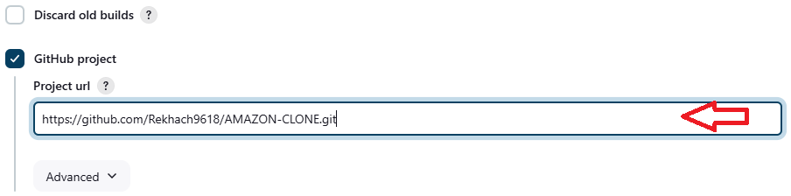
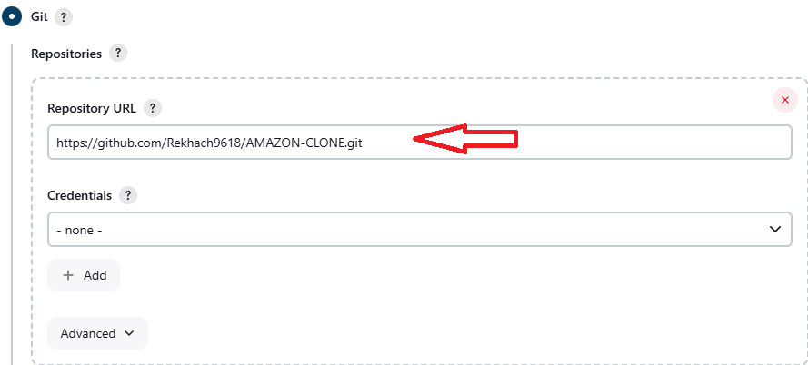
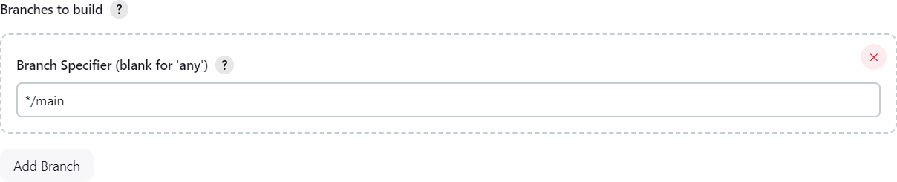
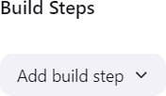

Slide 18
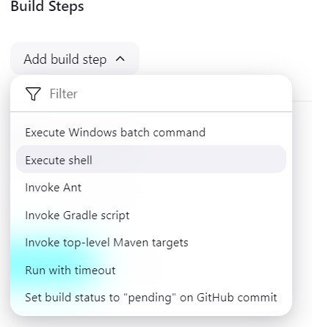
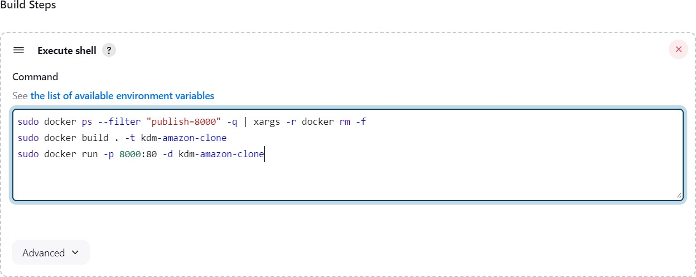


Slide 19

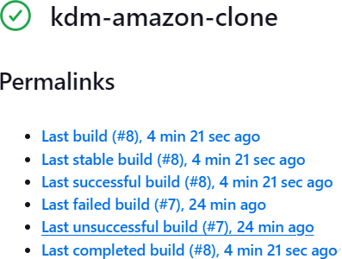
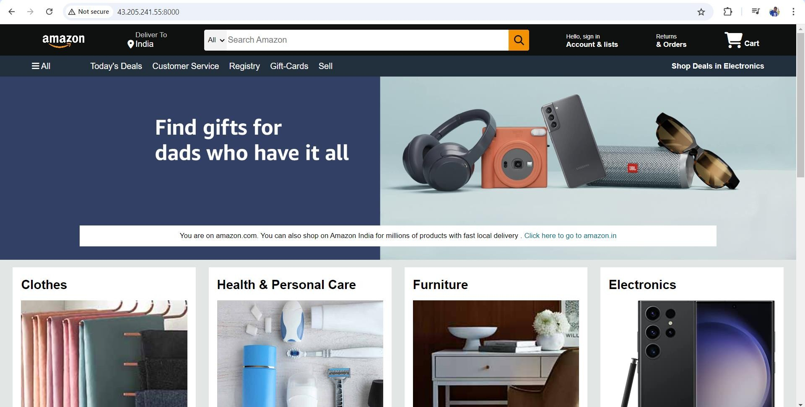
Before Clicking Build Now, Go to EC2 and do this:
Add in last line and save

Slide 20
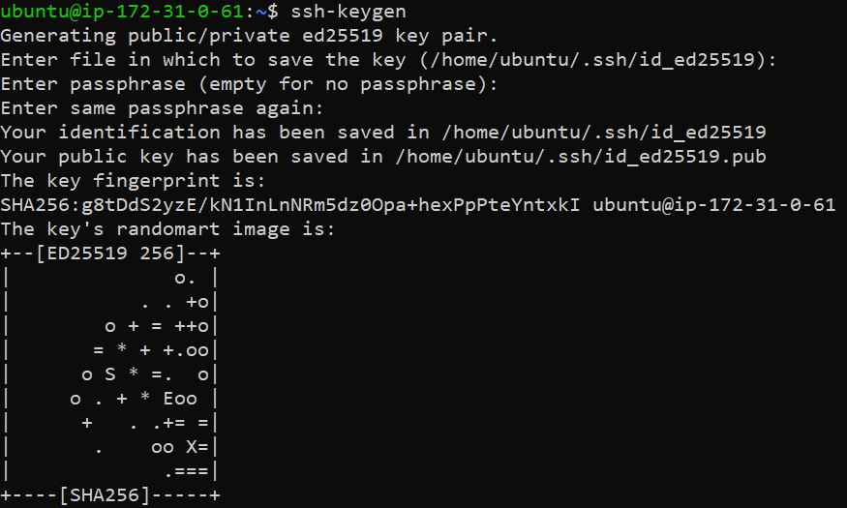
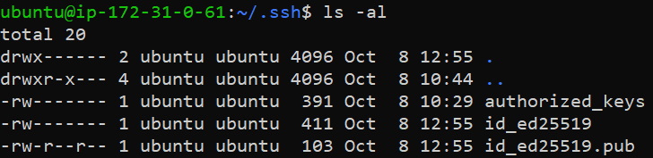
Automate Deployment Using SSH Keys and Webhooks
Generate SSH keys:
# Generate SSH keys
ssh-keygen
# Navigate to the .ssh directory
cd .ssh
# List all files
ls -al
# View public SSH key
cat ~/.ssh/id_ed25519.pub
# View private SSH key (use cautiously)
cat ~/.ssh/id_ed25519

Slide 21
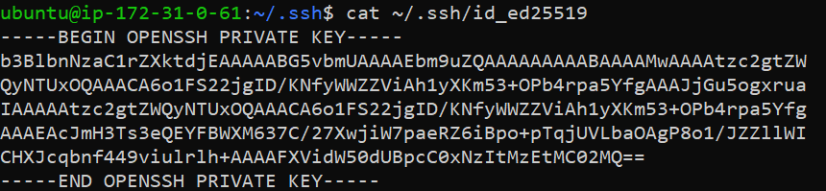
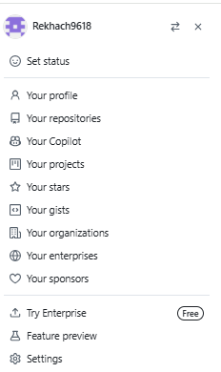

Copy the public key and add it to GitHub:
Settings → SSH and GPG Keys → New SSH Key.
Title: Jenkins Public SSH Key.
Key Type: Authentication Key.
Key: (Paste the public key).
In Jenkins, add the private SSH key:
Manage Jenkins → Configure System → GitHub Server:
Kind: SSH Username and Private Key.
Private Key: Enter the private SSH key manually.

Slide 22
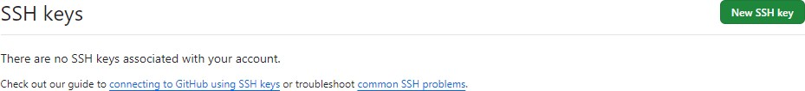
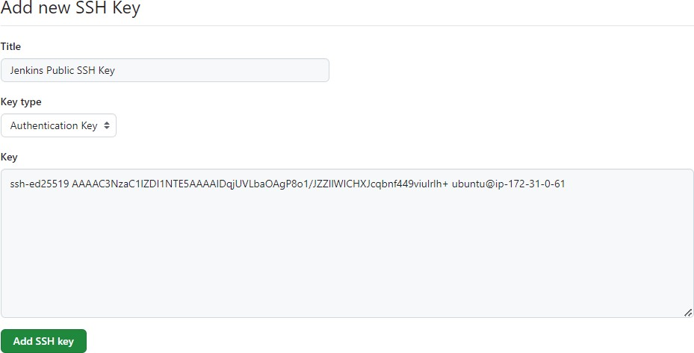
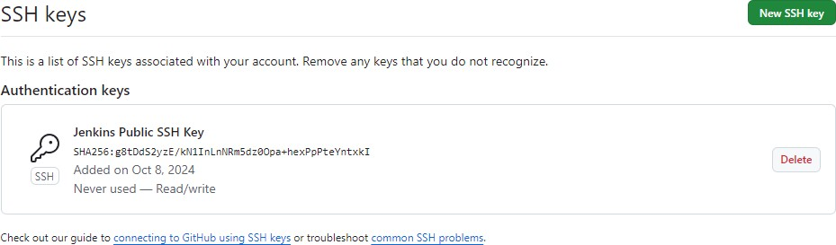
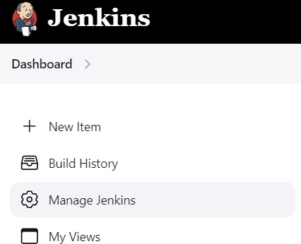

Slide 23
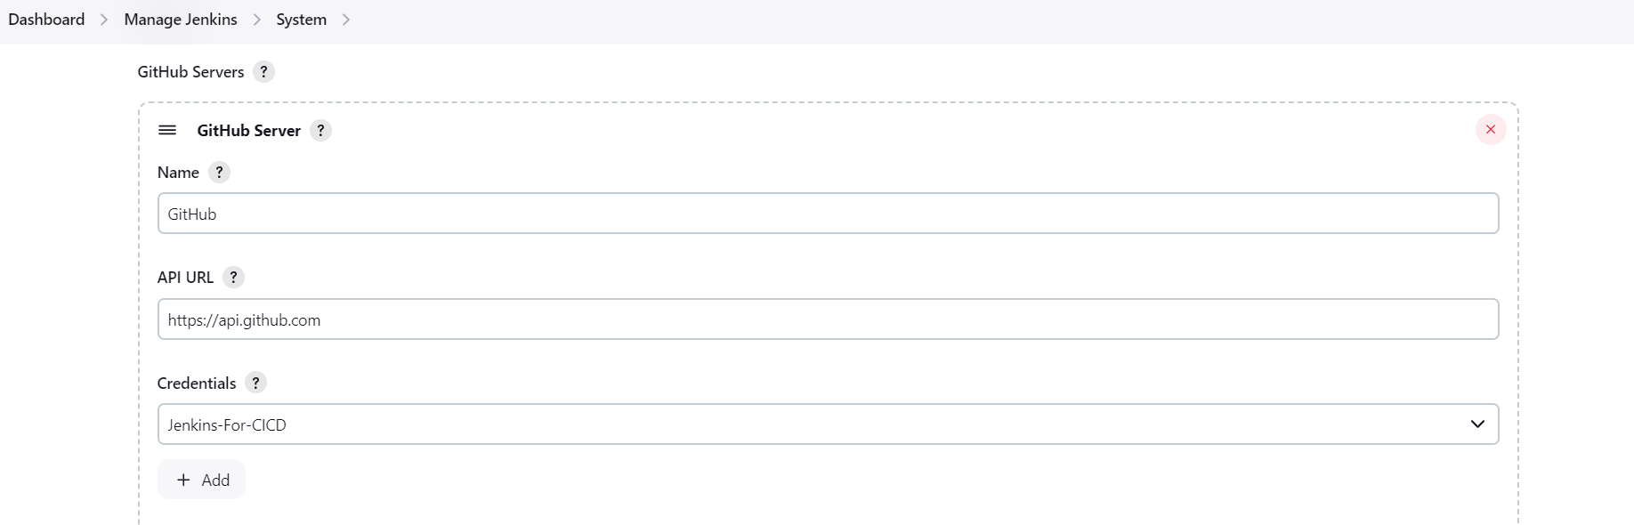

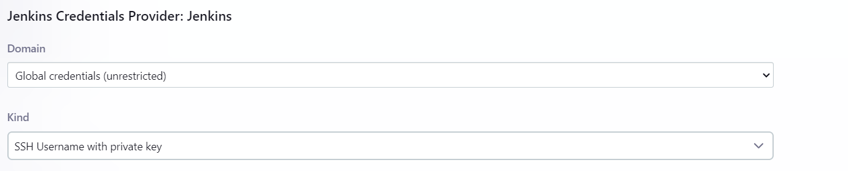
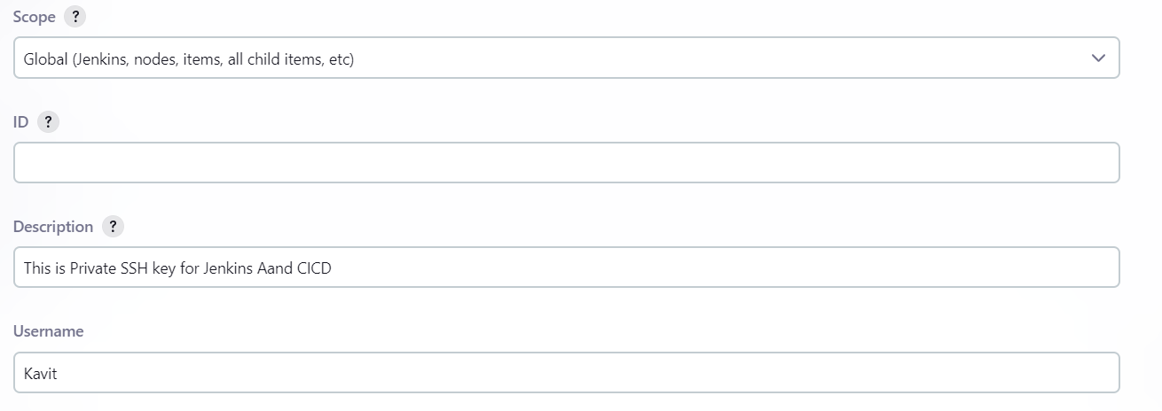
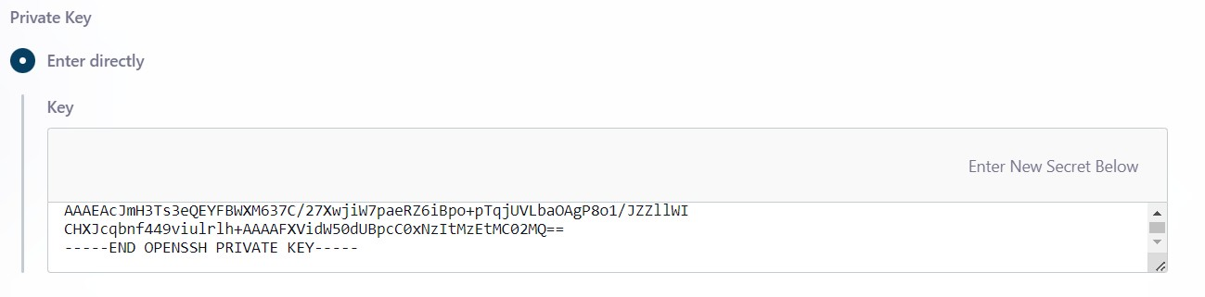



Slide 24
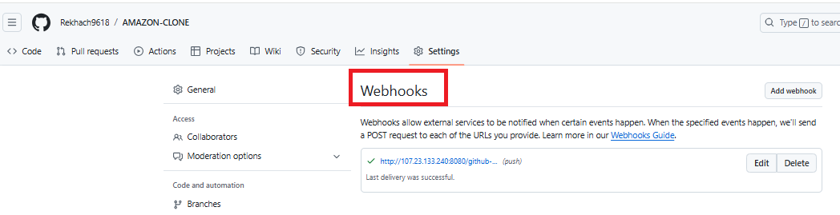
Set Up GitHub Webhooks
In GitHub:
Go to Repository Settings → Webhooks → Add Webhook.
Payload URL: http://43.205.241.55:8080/github-webhook/
Content Type: application/json.
Add the webhook.
In Jenkins:
Go to the kdm-amazon-clone Job.
Under Build Triggers, enable GitHub hook trigger for GITScm polling.

Slide 25



Slide 26



Grant Docker Permissions to Jenkins
Run the following commands to grant Jenkins permission to run Docker:
# Add Jenkins user to the Docker group
sudo usermod -aG docker jenkins
# Restart Jenkins and Docker
sudo systemctl restart jenkins
sudo systemctl restart docker
# Verify group membership
sudo su - jenkins
groups
# Should see "jenkins docker"
exit
Test Automatic Builds
Make a change in the GitHub Repository (e.g., modify index.html) and commit it.
Jenkins will automatically trigger the build process, and the web application should reflect the changes in real-time.

Slide 27





Slide 28


BEFORE:
AFTER:
Expected Outcome:
The expected outcome is an Amazon clone website hosted on an NGINX server running on an AWS EC2 instance. The CI/CD pipeline will be configured to automatically build, test,
and deploy new code to the EC2 instance upon any changes in the GitHub repository, ensuring an efficient, automated deployment process.
The integration of Jenkins and GitHub for continuous integration and deployment in this Amazon Clone project significantly streamlined the development and deployment workflow. It allowed for a more efficient development cycle, minimized errors, and ensured the project was delivered faster with higher quality. Through CI/CD automation, development teams can more easily maintain and update the website while focusing on delivering new features, rather than worrying about the deployment pipeline.

